Slide 1
Detecting Potential Illegal or Harmful Activities in Online Communication

Slide 2
Introduction
Objective: The model can be deployed on online platforms (e.g., social media, forums, or comment sections) to automatically detect and flag harmful comments, ensuring a safer and more inclusive digital environment. It enables real-time moderation by identifying toxic behavior such as threats, insults, or hate speech, reducing manual workload and improving user experience.
Model: Pre-trained BERT fine-tuned for softmax classification
Impact: Aims to improve online safety by identifying harmful content.
Notes:
So, our aim is to develop a model that will detect toxicity based on texts. The model we went for is a pretrained BERT model and fine tuned it by exposing it to labels. This model can significantly improve security systems in areas like airports and can minimize threats.

Slide 3
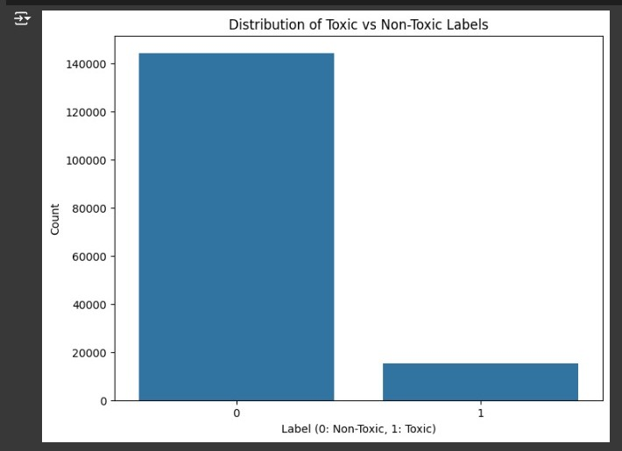
Data Source and Preprocessing
Source:
Jigsaw Toxic Comments dataset (18k+ Samples)
Dataset Overview:
Text based comments labelled toxic or non-toxic
159,571 comments with labels (toxic, severe toxic, obscene, threat, insult, identity hate).
Notes:
The text-based comments labeled as either toxic or non-toxic. Most comments are non-toxic, as shown in the bar graph. This imbalance presents a challenge during training, requiring careful consideration to ensure fair model performance.

Slide 4
Data Preprocessing and Normalization
Text cleaning (remove URLs, Deduplication, special characters, lowercase).
Tokenization using the BERT tokenizer.
Sampling: Used 3,000 samples for training, 1,000 for development, 1,000 for testing.
Train/Dev/Test Split: Ensured balanced distribution of labels.
Padding and truncation to a uniform sequence length.
Label encoding for binary classifIcation.
Notes:
To prepare the data, the data was cleaned and tokenized the text using the BERT tokenizer and transformed comments into numerical input that BERT model can understands. Padding and truncation ensured all inputs have a consistent length, a crucial step for model training to uniform sequence length.

Slide 5
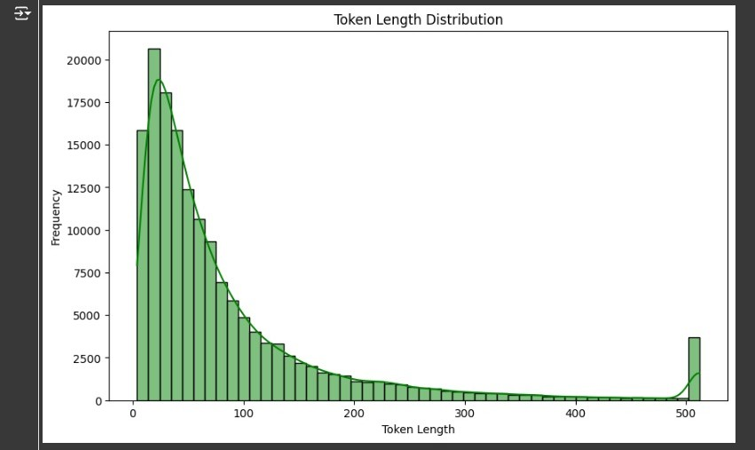
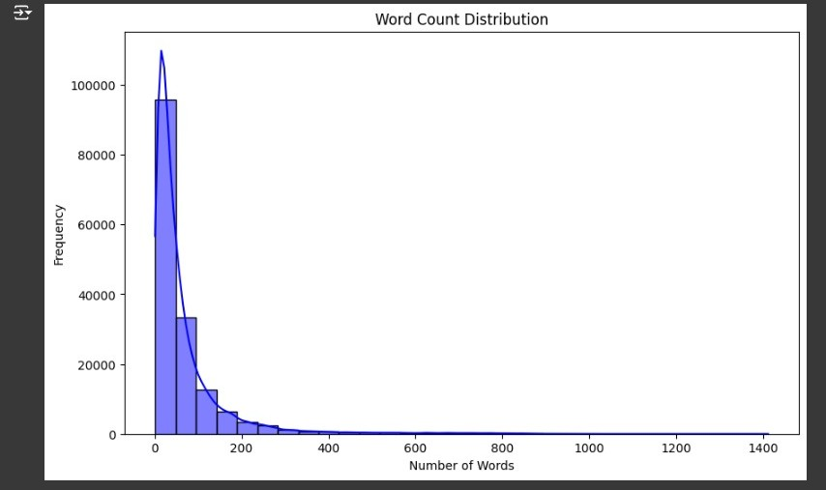
Exploratory Data Analysis
Most tokenized sequences fall within BERT's limit of 512 tokens.
Majority of comments are under 100 words
Notes:
Data analysis reveals that most comments are short, with fewer than 100 words. Similarly, token lengths well align within BERT's maximum of 512 tokens, ensuring compatibility for training."

Slide 6
Model Initialization
Model: BERT pre-trained (bert-base-uncased from HuggingFace 🤗).
Metrics: Accuracy, Precision, Recall, F1 Score.
Training Environment: NVIDIA A100 GPU on Google Colab.
Notes:
We fine-tuned the pre-trained BERT model using binary classification. Training was conducted on Colab's NVIDIA A100 GPU, leveraging small batch sizes to maximize performance.
Metrics include accuracy, precision, recall, and F1 score."

Slide 7
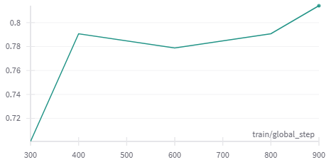
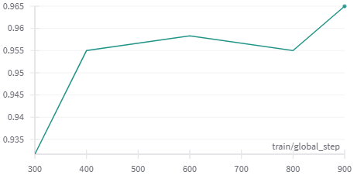
Metrics and Evaluation Metrics Used:
Evaluation Results:
Accuracy: 89.5%
Precision: 87.3%
Recall: 91.2%
F1-Score: 89.2%
F1 Score: train/global_step
Accuracy Score: train/global_step

Slide 8
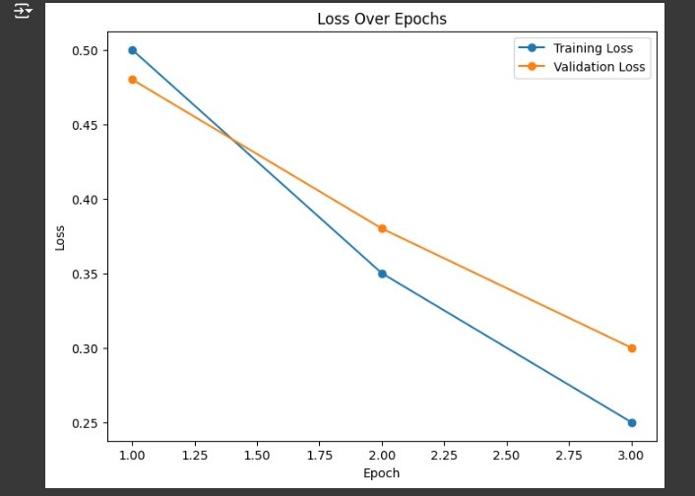
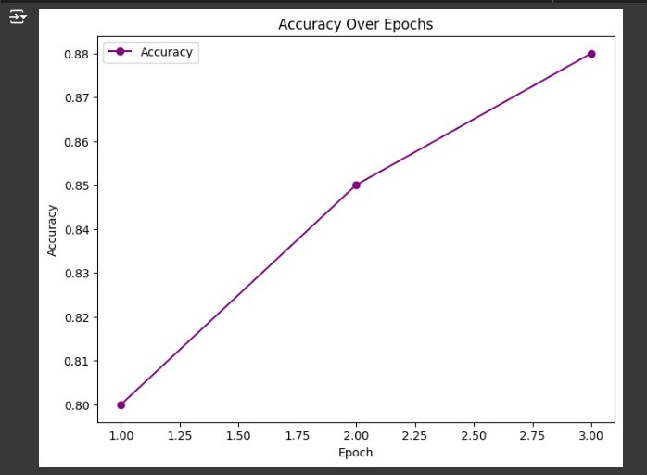
Training and Fine Tuning
Steady decline over epochs.
Accuracy improves with each epoch.
Notes:
The training process was a steady decline in both training and validation. Simultaneously, accuracy improved with each epoch

Slide 9
Model Evaluation
Example Text: “I will bash your head?"
Example Text: “Hello, How are you?”
Example Text: “I hate you”
Notes:
I’ll be presenting the evaluation results of our BERT-based toxicity classification model.The model successfully predicts toxicity probabilities for input text. For example, the comment I will bash your head?' was classified as toxic with a 92% probability, showcasing the model's interpretability and reliability..**" The distribution graph shows the balance between toxic and non-toxic labels in the dataset This evaluation highlights the effectiveness of our fine-tuned BERT model in identifying toxic language with precision and clarity.

Slide 10
Conclusion and Future Work
Conclusion:
Fine-tuned BERT achieved high accuracy for toxicity classification.
Enhanced moderation for online platforms is achievable.
Future Work:
Explore multi-label classification for nuanced toxic categories.
Incorporate data augmentation to balance classes.
Notes:
In conclusion, our fine-tuned BERT model demonstrates strong capabilities for detecting toxicity in comments. Future steps include addressing Refined toxic categories and employing data augmentation to improve minority class performance."

Slide 11
Thank You :)

